Slide 1
OEC 2018

Slide 2
Research
Kalman Filter
ARIMA

Slide 3
Our Algorithm (Deployed on Cloud vm)
15 data points, three quadratic curves
Performed quadratic regression on 5 points each and used
6 resulting parameters (a1, b1, a2, b2, a3, b3) to calculate a heuristic
Function parameters and criteria were manually tuned
Focusing on curvature, projected growth, and rate of change
Got around issue of API rate limiting

Slide 4
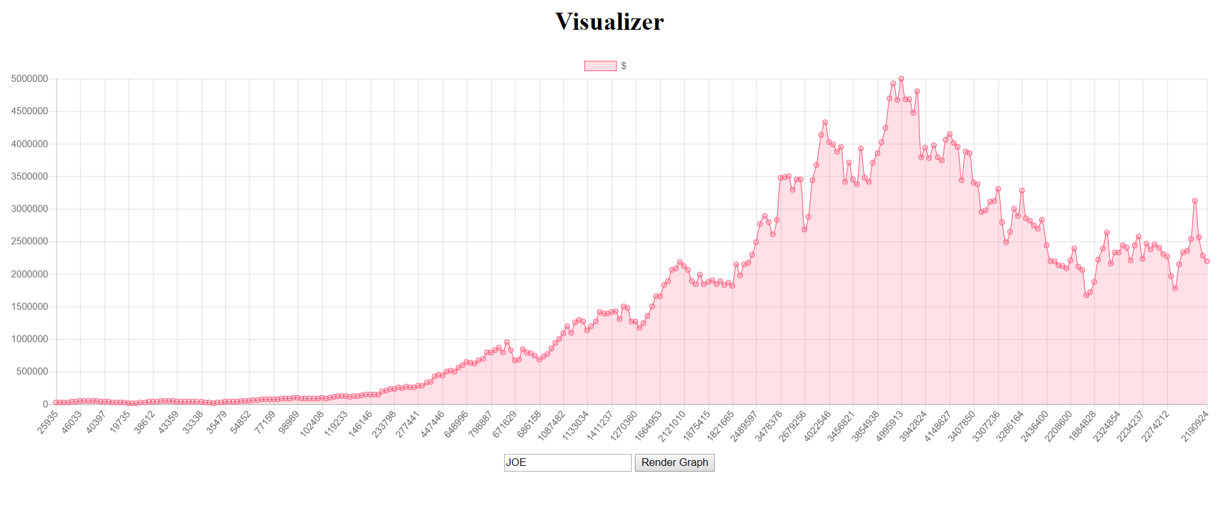
Visualizer (Deployed on DigitalOcean)

Slide 5
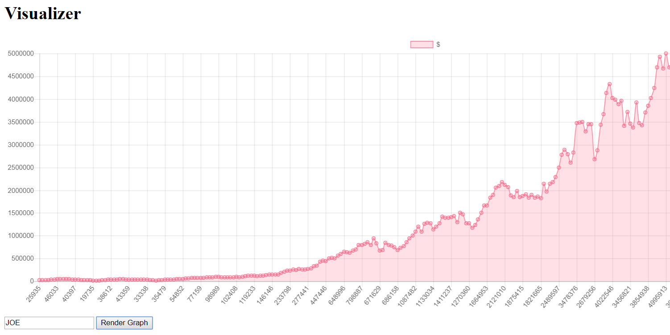
Issues
Westin Internet sucks (wasted a lot of time on package installation and waiting for the API to respond)
The API sucks
Rate limiting prohibited us from implementing a NN (we needed lots of data points but couldn’t “DDOS” the API)
We lost our JOE when Nikhil fixed his bug :’(
Someone unrightfully stole our API key

Slide 6
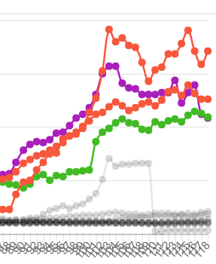
The $700K Bug

Slide 7

Thank you for listening!

